Slide 1

Studying 2024 EDUCAUSE
Group 3
鍾程黌Antony、林碩約Johnny、施盈琪Ella、胡禎Hailey、林天牧Temple

Slide 2
Embracing AI in Higher Education
AI can support student learning and be applied to all phases of learning in Bloom’s hierarchy, from content acquisition to creating original products that blend human and AI insights.
Al tools provide potential for transforming teaching methods and improving learning outcomes.
There is still a lack of widespread agreement about what constitutes appropriate use of AI-enabled technology for teaching and learning.
Along with great potential, AI tools bring great risk. e.g., social bias, academic integrity, data privacy, accuracy, etc.
Notes:
Bloom’s Taxonomy:
Remembering -> Understanding -> Applying -> Analyzing -> Evaluating -> Creating

Slide 3
Embracing AI in Higher Education
Focus on Ethics: responsible AI use in education
Enhance, Don't Replace: improve human work, not taking over
Collaborate with Colleagues: share experiences
Innovate Learning: personalized learning, assistive tools, adaptive technologies
Update Pedagogy: reevaluate assignments to ensure AI supports
Paradigm Shift: AI is set to transform higher education
Notes:
https://research.vitalsource.com/research
https://www.svsu.edu/cetl/facultylearningcommunitiesflc/

Slide 4
The Generative AI Teaching As Research (GAITAR) Initiative
Create and sustain communities of practice to foster adaptive and innovative teaching strategies, evidenced-based teaching, and applied education research.
Cultivate and support the design and implementation of effective teaching adaptations and/or innovations across disciplines and educational contexts.
Rigorously measure the impacts of educational uses of GAI tools on student learning, equity in student outcomes, and the student experience at CMU.
Center student voices and diversity, equity, inclusion, and belonging as instructors adapt to and/or innovate with GAI in teaching and learning.
Disseminate and foster adoption of transferable, evidence-based, educational applications of GAI tools.
Notes:
https://www.cmu.edu/teaching/gaitar/index.html

Slide 5
Finding Appropriate Uses for AI-Enabled Technology in Practice
AI Formative Practice in Teaching and Learning
Universities: University of Central Florida & Iowa State University
Partnership: Collaborated with VitalSource to integrate AI-generated formative practice
Impact: Promotes learning-by-doing, offers data-driven insights for faculty
Outcome: Improved student engagement
Emerging Technologies Faculty Learning Community (FLC)
University: Saginaw Valley State University
Participants: 18 faculty members investigating AI's impact on higher education
Focus: Exploring teaching method updates, course redesigns, and AI-driven curriculum enhancements.
Projects: Each faculty member is developing practical projects
Notes:
https://research.vitalsource.com/research
https://www.svsu.edu/cetl/facultylearningcommunitiesflc/

Slide 6
More AI-Enabled Uses in Education
AI-intensive Writing, Research & Inquiry Courses
University: Boston University
Purpose: Incorporate AI into their teaching ethically, responsibly, and effectively.
Approaches: AI affiliates work with instructors to test assignments and support students in ethical AI writing and research.
Outcome: Helps students develop responsible AI skills, and enables instructors to create AI teaching resources and lead professional development
AI Doubles
University: The University of Sydney
Purpose: Creating AI doubles for students to provide personalised support.
Impact: AI agents support personalized learning, offering instant feedback, study coaching, concept explanations, and group work facilitation
Outcome: Enables educators to transform their teaching practices by using AI to fill learning gaps and enhance student engagement and understanding
Notes:
https://www.bu.edu/dli/projects/ai-intensive-writing-research-inquiry-courses/
https://educational-innovation.sydney.edu.au/teaching@sydney/how-sydney-educators-are-building-ai-doubles-of-themselves-to-help-their-students/

Slide 7
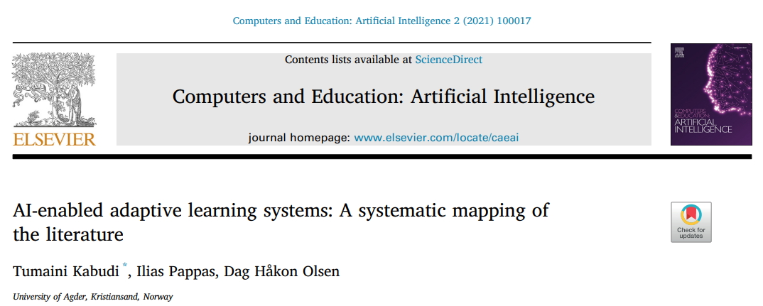
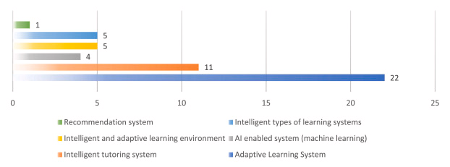
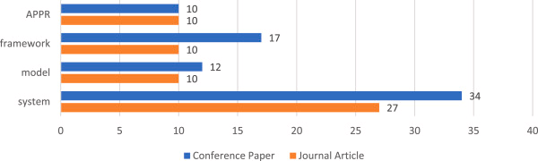
Analysis & Trends in AI-Enabled Adaptive Learning Systems
Analysed 147 studies published between 2014 and 2020.
Adaptive learning system, intelligent mechanisms and adaptive learning platform and frameworks for adaptive learning were the most proposed and utilised interventions.
Most of the systems and frameworks that have been designed and proposed are currently in their experimental phases.
As AI-enabled learning systems evolve, future research should keep a close eye on the developments with regard to the inclusion of more advanced techniques, such as deep learning and natural language processing.
Notes:
https://www.sciencedirect.com/science/article/pii/S2666920X21000114
system (adaptive learning system, intelligent mechanism, or adaptive learning platform)
Frameworks are constructs that define concepts, practices, values and assumptions as well as provide a set of guidelines on how to implement the frameworks.
model is ‘a pattern of something to be made, a description or an analogy used to visualise and reason about the system to be developed and its likely effects’.
An approach refers to a set of viewpoints or theoretical concepts applied to understand, explain and solve a problem observed in a particular phenomenon.
The most identified AI-enabled learning systems in the mapping were Adaptive Learning Systems. Another most identified kind of AI-enabled learning system in the mapping is intelligent tutoring systems.

Slide 8
How do we use AI Responsibly?
Data Privacy
Data Collection Privacy
Compliance with Laws (e.g California Privacy Rights Act)
Informed Consent
Aligned Interests
Data Usage
Opt In & Easy Exits
Data Sharing
Health and Well-Being
Data Collection
Privacy and Security
Third Party Disclosure
Conversational Transparency
Communication
Laws and Regulations
Debiased and Explainable AI
AI Training and Development
Relevancy
Curriculum Alignment
Support
Tutorial/Training
Engagement & Interactivity
Age Appropriateness
Community Resources
Customer Support
Ease of Use
User Interface
Learning Curve
Accessibility Features
Notes:
https://blog.tcea.org/rubric-checklist-assessing-ai-tools/
https://hbr.org/2023/06/13-principles-for-using-ai-responsibly

Slide 9
How can AI be used without breaching academic integrity?
Instructor allowed and user use it exactly as approved
Suggest that user include an acknowledgment of how you used the AI, including prompt(s) and the generated output with assignment.
A study aid to prepare for exams
User cannot upload content professor created without their consent as otherwise user may be infringing on their copyright.
A study aid to improve your understanding
Evaluate the generated content for accuracy
An example to use for critical discussion
Notes:
https://libguides.tru.ca/artificialintelligence/appropriateuses

Slide 10
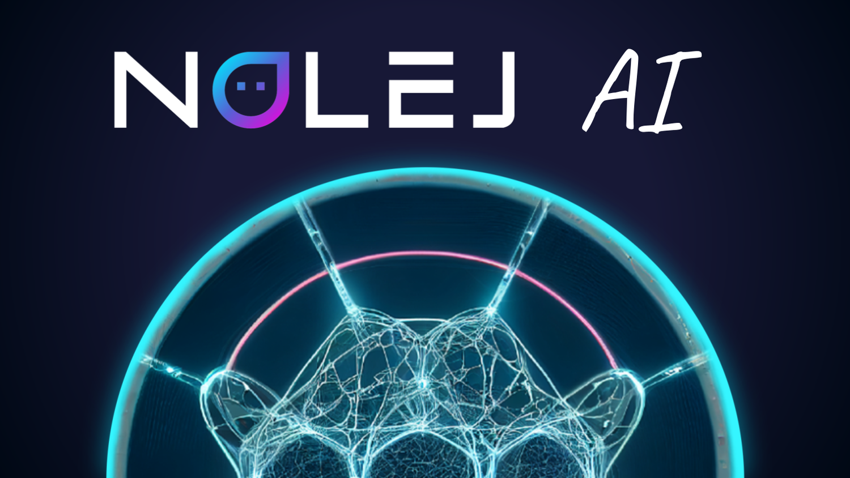

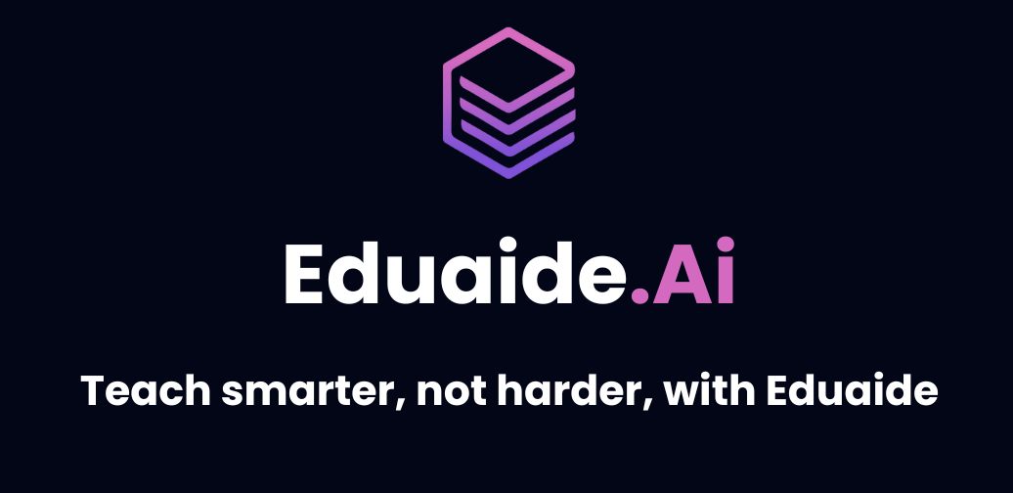






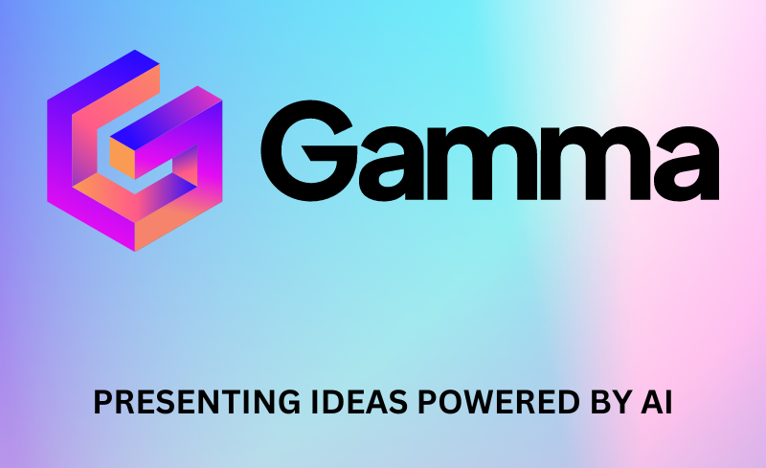


AI Tools for Different Educational Purposes
Perplexity AI: For research and source identification.
Eduaide AI: Educator's assistant to reduce workload.
YAMM: For email effectiveness.
ChatDOC: To interact with PDFs.
Hemingway Editor: For writing improvement.
ChatGPT: Language learning and assessment.
MagicSchool AI: Instructional enhancement.
Curipod AI: Lesson planning.
Gamma Presentations: Learning transformation.
Lumen5: Microlearning videos.
Nolej AI: Building background knowledge.
Artflow AI: Digital storytelling.
Morpheus AI: Image generation for creativity.

